Slide 1
Nurturing Collective Capacities & Voices of Youth Workers
Ocean in a Drop++
Experiences from India and our Commonwealth partnerships
For Youth workers
Notes:
on the cover

Slide 2
How do young people spend their time?
What spaces do they usually occupy?

Slide 3
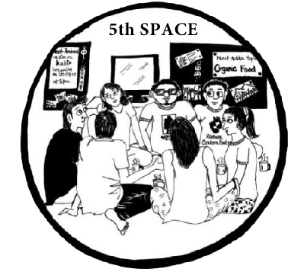
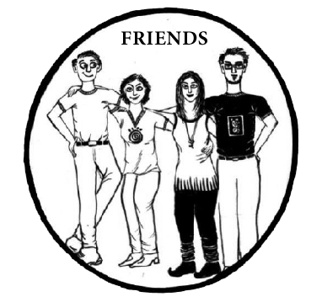
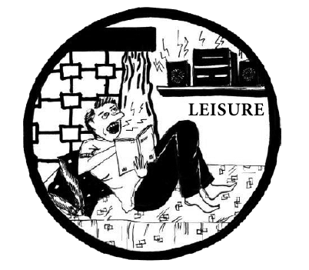
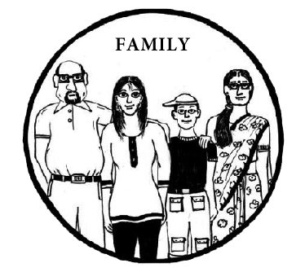
Spaces young people occupy: What is Youth Work?
Nurturing Youth Spaces – The 5th Space
A space where young people step out to discover themselves - through Self to society journeys
Volunteering, civic action, travel for self-discovery, and new social exchanges
Co-created and co-led by young people and youth workers
An experiential-refl-active space where feelings are honored

Slide 4
Co-creating 5th Spaces: The 5 Feelings Experience
Love
Ownership
Social Hope
Learning/Growth
Freedom

Slide 5
The Indian Youth Work context
Nation’s Opportunity
Personal aspirations of young people of good education, health, employment, social inclusion, and well-being of self and society and needs of National imperatives of growth, sustainability, development, and harmony as well as well-being for all.
Challenge
At least 3 million suitably skilled youth workers required to enable young people reach their best potential.
Demographic Advantage
Nearly 40 percent of the Indian population - 13 to 35 years
333 million youth ( 15 -29 years representing 27.2 % of the Indian population*
All diversities of gender, caste, class, religion, region, languages, sexual orientation, abilities, etc.
* https://www.researchgate.net/figure/Youth-population-15-35-year-and-their-share-of-total-population_tbl1_329782820

Slide 6
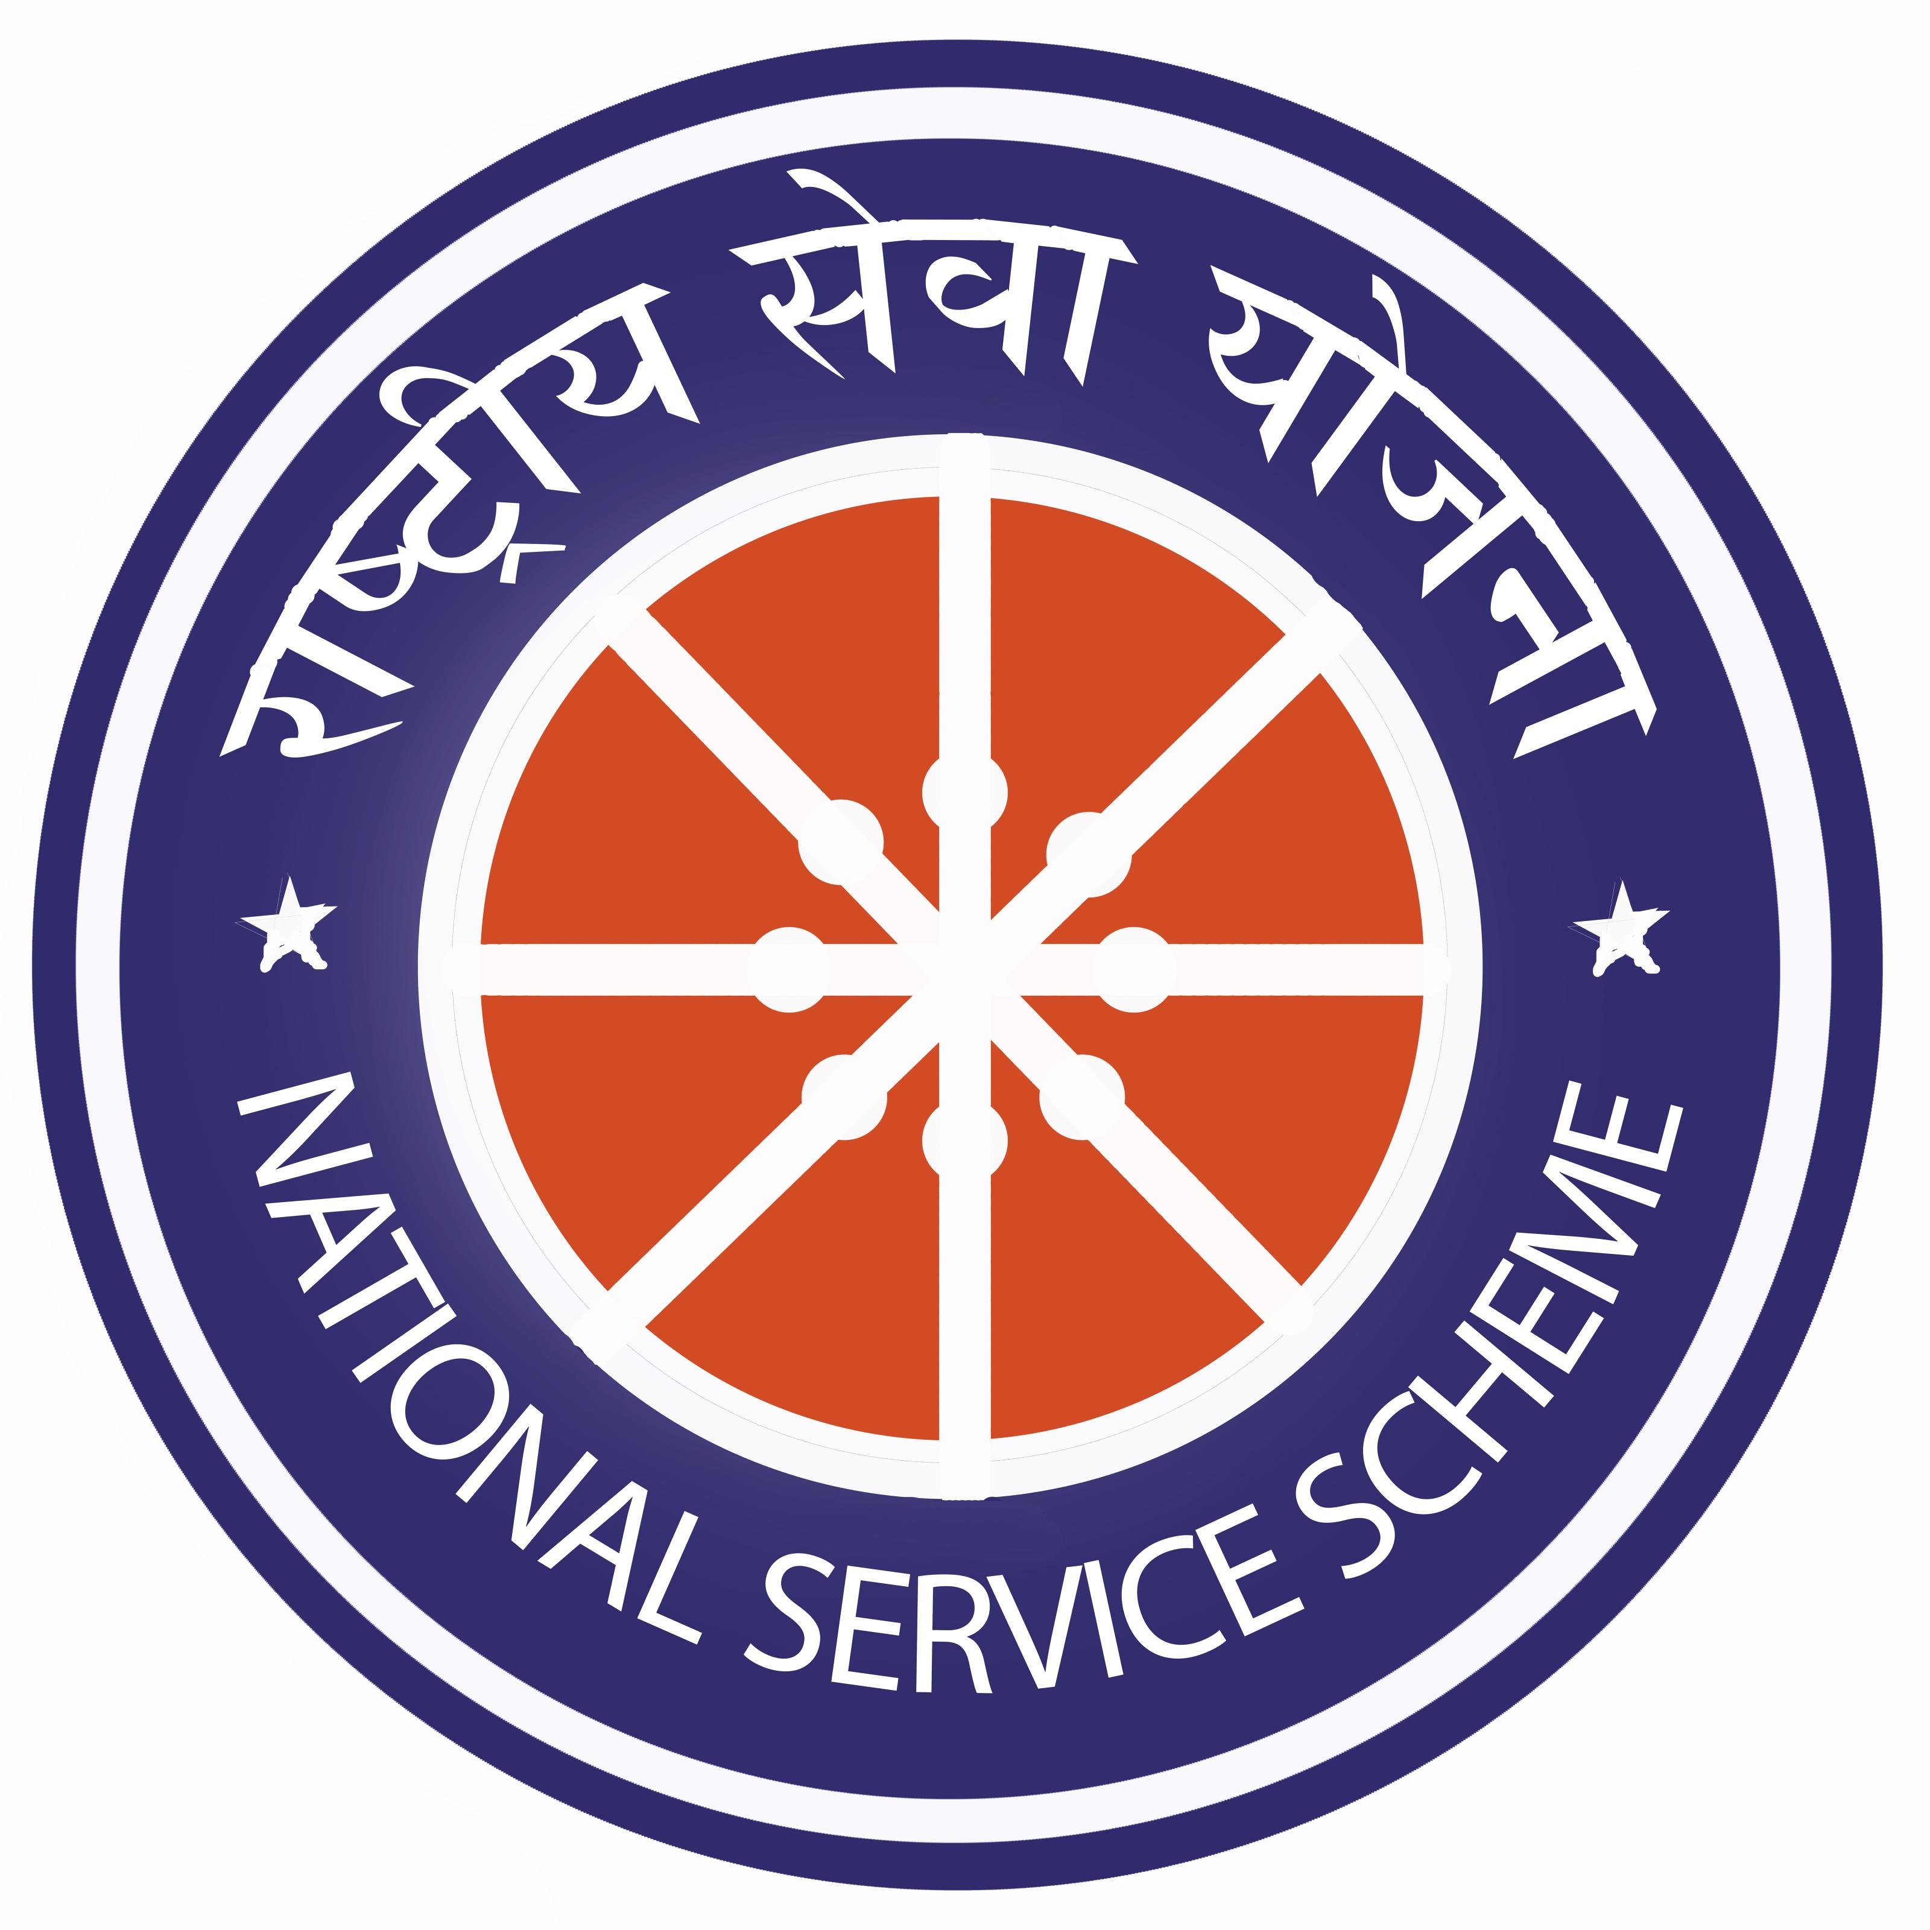
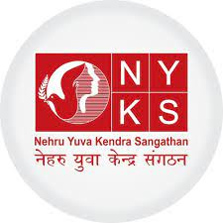
Who are India’s Youth Workers?
The World’s Largest Youth Program run by Ministry of Youth Affairs and Sports
Social Sector Organisations, Education, and Informal Spaces
Thousands of Youth Development Organisations
(Ex. Pravah, Dream a Dream, Samvada, Gandhi Fellows, Teach for India, ComMutiny- The Youth Collective, the vartaLeaop Coalition, ICYO member organisations e.t.c )
4 Million Youth
30,000 Colleges & Schools
8.43 Million Youth 2.98 lakh Youth Clubs
Several other youth initiatives under the National Ministry Programs and UN agencies such as UNICEF, Yuwaah and UNFPA giving top priority to youth work
Several Educational institutions, schools, colleges, and Universities, Community-Based Organisations, Public and Private sector institutions
Our Challenge: How do we build prepare youth workers at scale ? To include formal and informal, fulltime, part time Youth Workers, Community Workers, Educators, Counselors, Health Workers, Social Workers, School Teachers, Extracurricular and Sports Coaches, Employers and Parents and Peers are Youth Workers too!

Slide 7
Our Flagship Program: Preparing Youth Workers at Scale
A Pravah experiential learning journey to build professional competencies of youth workers in both formal and informal settings
For Youth workers

Slide 8
‘Ocean in a Drop’ classical journey outline
6-8 days of immersive retreats- over 3-6 months || Individual coaching (2- 5hrs) || Action project
4 Modules
Challenges & Learning imperatives for youth workers.
Youth spaces, needs and aspirations
Theories of youthhood
Principles of the 5th Space
Understanding Youth Experience
I
II
ADDIE model of instructional design
PSMART learning objectives
Session design using Walker’s Cycle
Facilitation using IGNITE model
ID and Facilitation
‘Tatva’ organizational elemental model
Systems thinking Laws
From problem solving to paradox thinking
System Thinking
III
Who are We? Evolutionary Niche human beings’
Who am I? - Mapping multiple identities
Telling and interpreting authentic stories
Discovering my essence as a Youth Worker.
Deep Self awareness
IV

Slide 9
*Ocean in a Drop ++ India, the impact so far
Youth Workers in the journey:10877
1. Classical journey – 796
2. Modular Programs -9115
87% of youth facilitators navigated their organizational challenges using inputs from OID***
Young people reached - **1 million young people per year
89% have strengthened their youth programming post OID***
Partnership with deemed university - Tata Institute of Social Sciences
Tools taught in OID are used by 300 organizations
Evolution of OID to OID ++ - *Ocean in a Drop Modular Journeys emerging from a need for customization to suit diverse youth worker populations,
organizational contexts including government program priorities linking to issues of health, wellbeing, peace, entrepreneurship, life skills, employability, etc.
At least 100 such customized modules journeys were developed in partnership with different entities
** Conservative estimate – 1 Youth Worker reaches at least 100 young people intensively every year.
*** From a longitudinal study with 100 participants of OID from 81 organizations

Slide 10
Ocean in a Drop – Sri Lanka A CYP and PYWA
Development of OID version customized for Sri Lankan context
Mentoring and Coaching of Youth Workers over a year
OID embedded into youth worker training curriculum in partnership with PYWA, Commonwealth, and Sri Lankan Government

Slide 11
Ocean in a Drop International – Commonwealth Pilot Edition
A GLOBAL COHORT
8
Commonwealth
countries
15
Youth Workers
The 1st virtual version in partnership with CYP & CAYWA

Slide 12
Glimpses of Core Features
Commonwealth solidarity
Peer learnings
Action project and Champions Challenge
Layne Robinson,
Head of Social Policy Development
at Commonwealth Secretariat
welcomes everyone to
Ocean In A Drop-International journey
C
A
YWA
Faculty and Coaches
Fun, Food after After Parties
Final certificate and celebration

Slide 13
"The key takeaways for me are the tools OID has provided us during the exploration of the various thematic areas within the course“ Daniel, Activate! South Africa
Feedback & Verbatims Snapshot
"This has been an eye opener for me. Diving deep into myself and reflecting on where I was, where I am today, where I want to be and how do I get there. The opportunity to share in space where you felt trusted and free was greatly appreciated “ Jessie, Gov. Division Of Youth, Grenada
”This has been life changing for me. It was great to know that there are more youth workers like me who believe in concepts like love“ Denese, Activate! South Africa.
"It is easy to come up with ideas but executing them in a proper way where they actually achieve the goal you intend to, is difficult. OID has given me the structure and tools I require to design an efficient youth-centric program, and for that, I am very grateful.” Lakshmi, YCM India

Slide 14
Come join the Ocean In a Drop Commonwealth Journey
Together we nurture capacities of youth workers at scale.. THANK YOU!

